Slide 1
Aren’t we all sinners? 1 Corinthians 5

Slide 2
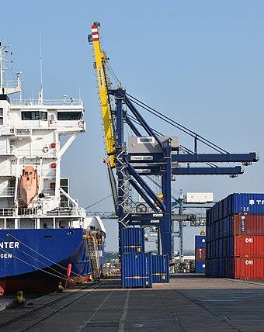
Terrible Choices

Slide 3
Objections
Aren’t we all sinners (verses 1,2)

Slide 4
Objections
Aren’t we all sinners
This is terrifying… (verses 3,4)

Slide 5
Objections
Aren’t we all sinners?
This is terrifying…
This is unloving (verse 5)

Slide 6
Objections
Aren’t we all sinners?
This is terrifying…
This is unloving (verse 5)

Slide 7
Objections
Aren’t we all sinners?
This is terrifying…
This is unloving
This is a danger to the church (verses 6-8)

Slide 8
Objections
Aren’t we all sinners?
This is terrifying…
This is unloving
This is a danger to the church
This is impossible (verses 9-13)

Slide 9
Objections
Aren’t we all sinners?
This is terrifying…
This is unloving
This is a danger to the church
This is impossible
Who am I to judge?

Slide 10
And if that’s not me…?

